Slide 1
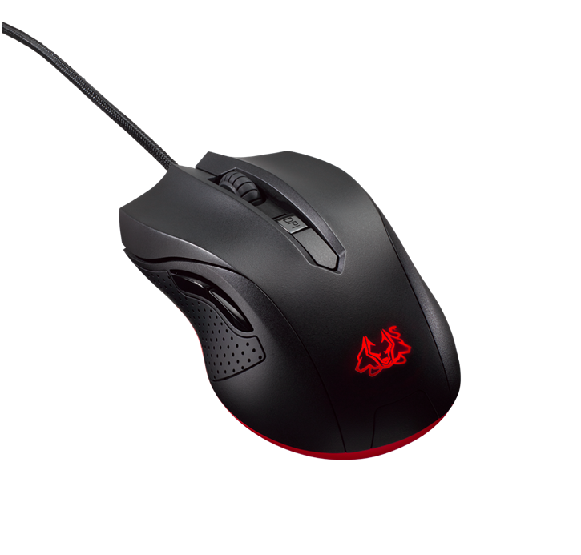
MACHINE INTELLIGENCE AND EXPERT SYSTEMS
TERM PROJECT
USER AUTHENTICATION USING MOUSE DYNAMICS
GROUP: 8
Ravi Ghadia 17EC10045
Shubham Maheshwari 17EC10055
Arpit Dwivedi 17EC35005
Pankaj Mishra 17EC35034
Wayal Rushikesh 17EC35044

Slide 2
Contents
Introduction
Problem Statement
Understanding Self-Organizing Maps
Methodology
Data preprocessing
Features Extracted
Building the classifier

Slide 3
Introduction
In today’s data driven world, data protection and privacy are of prime importance.
Digitization of all things and IoT have made previously safe devices susceptible to unauthorized access by foreign entities.
Conventional security features such as passwords and encryption are no longer adequate.
A novel way of authenticating users in such cases might be to judge the user based on their behavior, which is not something that can be easily reproduced by unauthorized users.

Slide 4
Problem Statement
Task: To Authenticate the user by training and testing your assigned classifier by the data acquired for continuous authentication data.
Design an algorithm using Self Organizing Maps to differentiate an imposter from the authentic user.
The purpose of such a system could be to authenticate a user based on the Mouse usage and may restrict usage if he/she is detected as an intruder.

Slide 5
Raw Data
Mouse strokes are analysed for detecting patterns in the biometric authentication system, that is, the classifier ▪ A mouse stroke is the set of points between two mouse clicks ▪ The mouse contains the following information: - Mouse move - Mouse press - Mouse release - Mouse drag - X,Y coordinates of the screen ▪ Processing is done on strokes to extract spatial and temporal information ▪ The statistics of the above information is analysed to create features that are inputs to the classifier

Slide 6
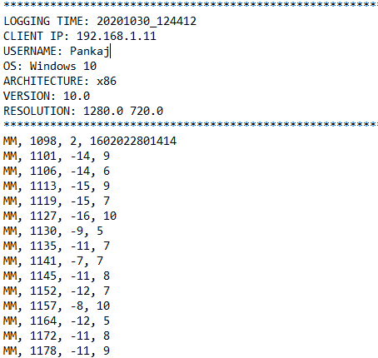
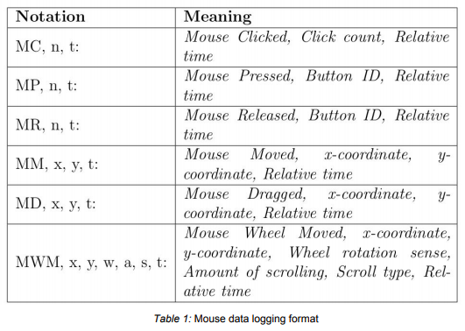
Acquired Data Format
Table 1: Mouse data logging format
Fig 1: The format of data saved by the software

Slide 7
Features extracted
The data from the raw dataset files can not be used to trin and thus we need to extract features from them for our purpose. We mainly try to focus on Mouse Movements and Mouse Clicks as those were the two kinds of dynamics occurring most frequently in every dataset:
Click time: Time the user takes to click the button.
Pause time: Time elapsed between pointing at an object and clicking it.
Linear Movement: Movement of the cursor(both along x and y axis)
Velocity: The velocity vector of the cursor(both along x and y axis)
Acceleration: Acceleration vector of the cursor(both along x and y axis)
Angular Movement: Movement of cursor along the angular axis.
Angular Speed: Speed along the angular axis.
Curvature: Rate of change of angular movement w.r.t linear movement.
For the above vectors, statistics like mean, standard deviation, maximum, minimum, range etc. about these quantities were stored as one datapoint. Several other temporal information such as no. of pauses, pause time, pause time ratio that act critical in depicting behaviour were also mined.

Slide 8
Extracting information
To extract information we make use of SOMs or self-organizing maps.
SOMs are a type of Neural Networks with a typical difference in the way in which they are trained. Instead of classical methods of updating the weights of a Neural Network using SGD or some other gradient descent, the weights of SOM are updated using a three step process:
Competition
Cooperation
Adaptation
Broadly speaking, what SOM basically does is dimensionality reduction.
Say we have a d-dimensional (d>>2) dataset of N points and we train an SOM model of size AxB neurons. Then, one of these AB neurons will be the winner neuron (called the best matching unit) for each data point and the dimensionality of the data has been reduced from d to 2. (x and y coordinates of the BMU)

Slide 9
Building classifier
For the classifier, we have used a Custom SOM Library: SuSi package. This package offers several SOM based models for clustering, regression, and classification. We have used the SuSi classifier for our purpose. The SuSi package SOM classifier makes use of two layers of SOM model, that are trained in a different manner: One using unsupervised training and the other using supervised training
Given an input datapoint, the unsupervised layer will first assign a BMU to it and then the supervised SOM assigns a target label to the given datapoint. Note that to train a SuSi classifier, it first trains the unsupervised layer and then uses this trained unsupervised layer to train the supervised layer. The learning rate and neighbourhood spread is decreased with iterations for better convergence.

Slide 10
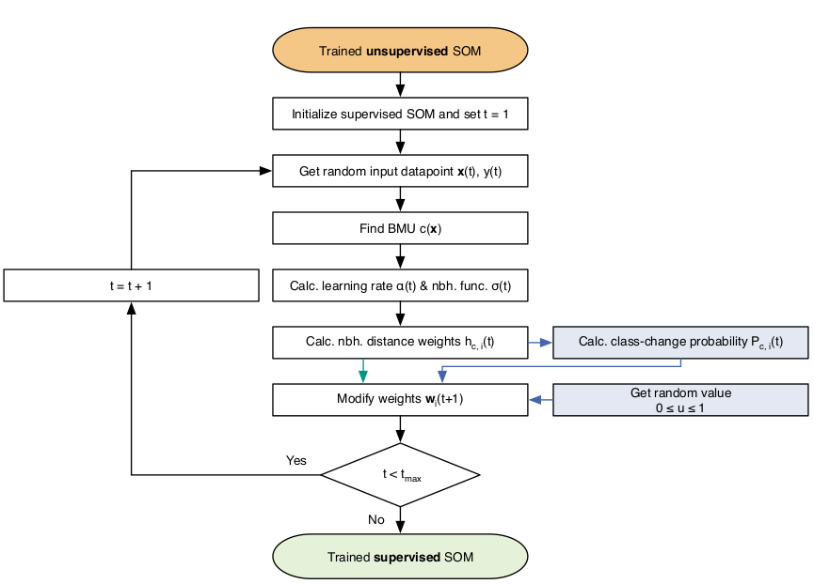
SuSi Classifier
Flow chart depicting SuSi Classifier

Slide 11
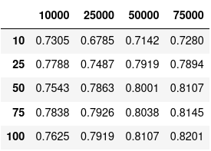
Results
The 5 fold cross validation results were obtained as follows:
Accuracy: 82.54%
F1 Score: 82.21%
Hyperparameter tuning was done using grid search, evaluating and selecting the set of hyper parameters which returned the maximum accuracy.
F1 score is equal to the hypergeometric average of recall and precision and a good F1 score implies good precision and recall. For security breach detection it is extremely important to have good recall (true positives / actual positives) so that all the actual imposters are detected correctly. Using the above hyperparameters we achieved a recall of 80.89%.
Table for hyperparameter tuning
Columns:: iter, index:: no. of rows

Slide 12
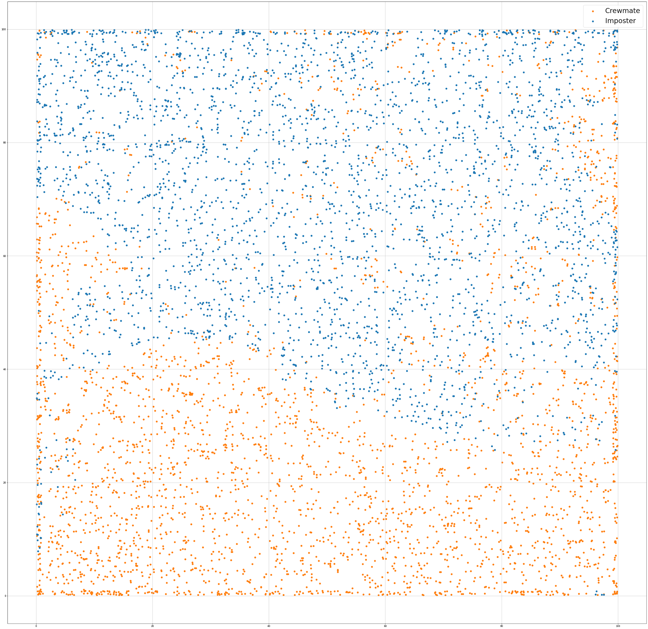
Distribution of the best matching units for the training data (with noise added for better visualization )

Slide 13
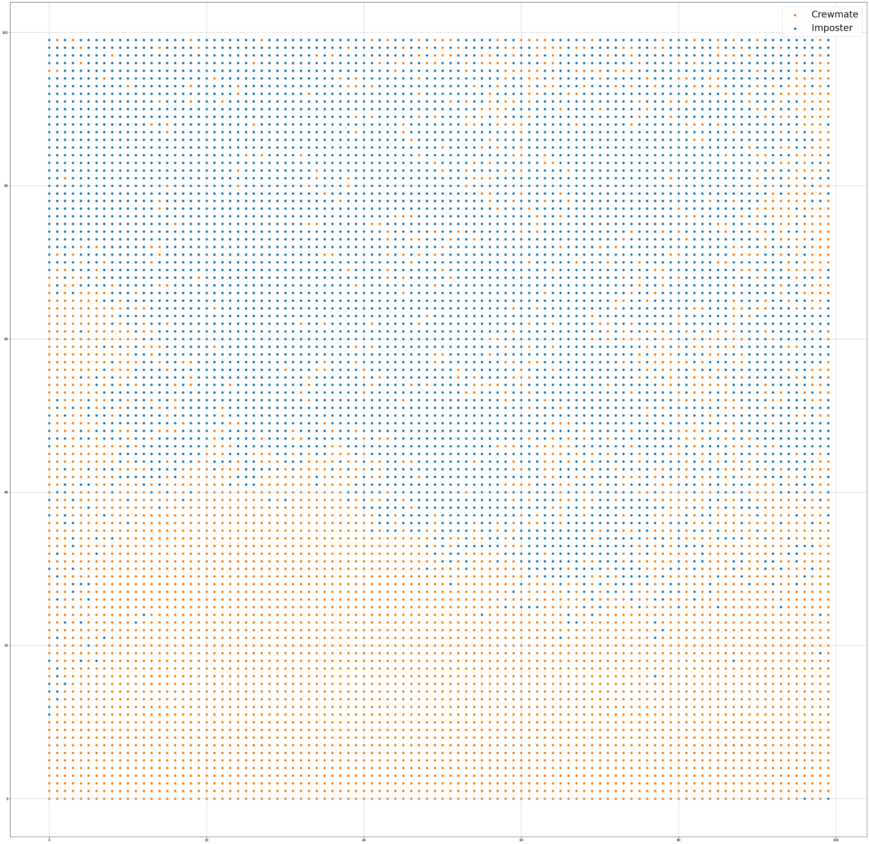
Distribution of the output labels corresponding to each neuron

Slide 14
Thank you!

